Slide 1

World record Soaring trough the clouds LIve demo of 19 Oracle Public cloud services
The Oracle ACE Soaring Clouds Team
Oracle OpenWorld 2017
2nd October 2017, San Francisco, USA

Slide 2
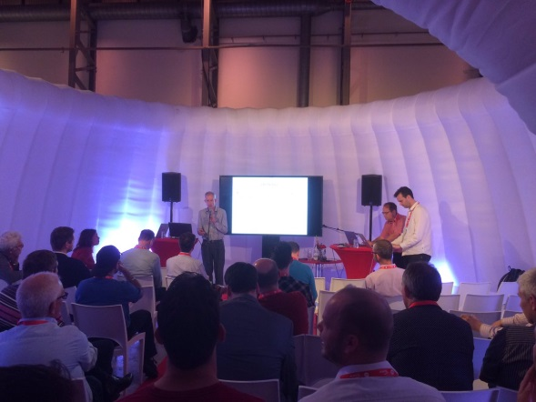
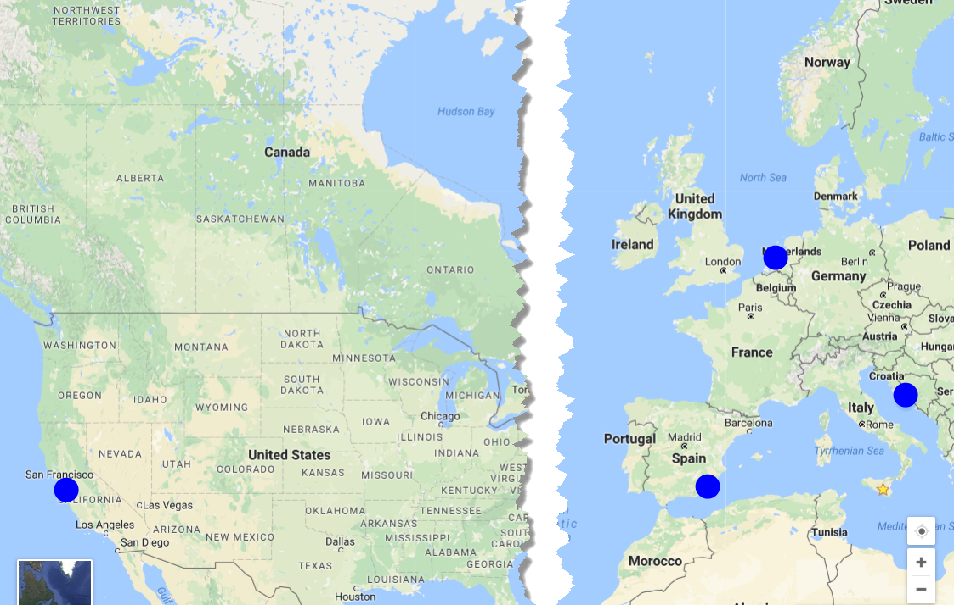
Soaring through the clouds
Prepared by international team of Oracle ACEs
Presented five times before today:
Valencia, Spain, March 2016
Katwijk, Netherlands, June 2016
San Francisco, USA, September 2016
Split, Croatia, March 2017
Amersfoort, Netherlands, June 2017
Objective: demonstrate live a working end-to-end integrated flow using Oracle PaaS Cloud Services
and provide insight in how it is created and what the main challenges were

Slide 3


end-to-end integrated flow using AS MANY Oracle PaaS Cloud Services as possible

Slide 4
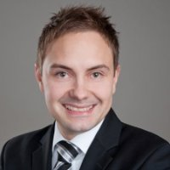
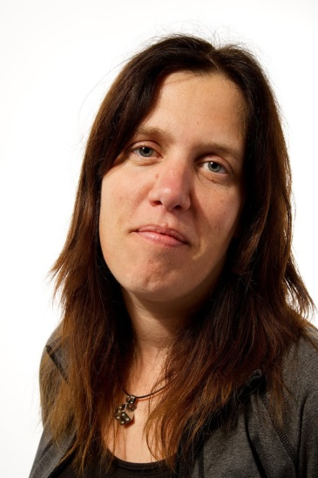
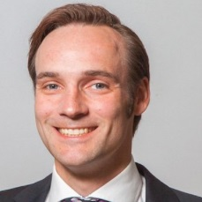
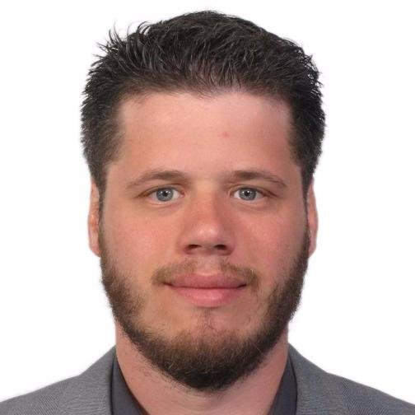
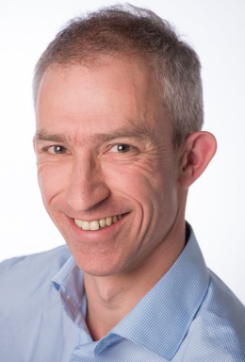
The Team
Distributed
Three countries, Four partners, Five Locations
The Cloud is omnipresent
except when there is a form of outage

Slide 5







Business scenario (2016)
Analyze Twitter traffic
& Voting Machines
Evaluate Proposal
Publish Enriched Approved Proposals on Web Portal
Oracle OpenWorld 2017

Slide 6
Extended business scenario (2017)
Provide end to end monitoring at business and IT level
Analyze Twitter traffic
& Voting Machines
Evaluate Proposal
Lower cost/increase speed of using 3rd party APIs
Send email,
Update Document, …
Publish Enriched Approved Proposals on Web Portal
Access Artist proposal through Chat client
Publish Business APIs
Publish through Mobile App
Oracle OpenWorld 2017
Use automated collaboration platform with source control and continuous delivery

Slide 7
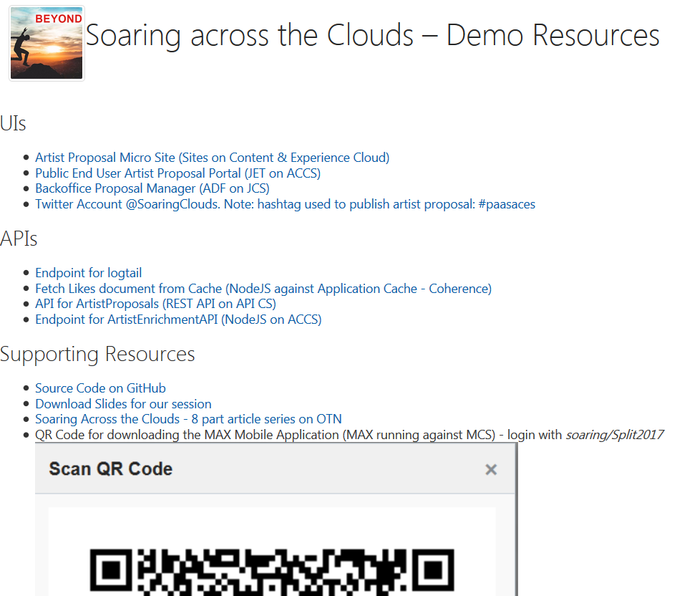
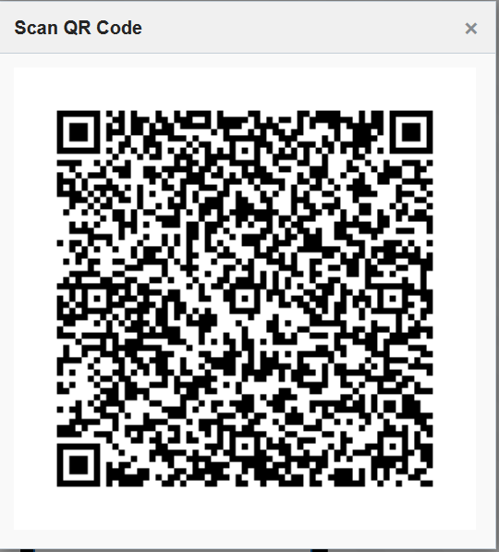
Live Endpoints & Resources
http://tinyurl.com/paasaces

Slide 8


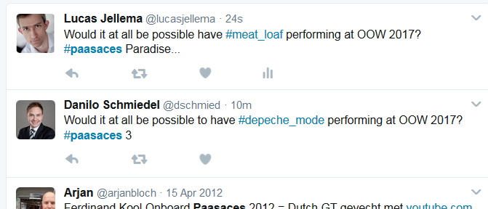
Now you tweet your Artist Proposal for OOW 2017
Use the hashtag #paasaces to get noticed
and add your favorite artist using another hashtag
Note: use underscore for space

Slide 9
Add slides on individual cloud services

Slide 10
Conclusion
What about that world record?

Slide 11









Cloud services architecture++
Real “Things” (Pis, Arduino’s, …)
Data Vizualization
Application Cache
Audience
(O)SSI
IoT CS
ACCS or Functions
DBaaS
LA
LA
ICS
Container Cloud
Event Hub
SOA CS
OMC
(APM, LA)
Experience CS
PCS
APM
JCS
LA
Messaging Cloud Service
APM
Visual Builder Cloud Service
LA
API P
MCS
Doc CS
Conversations (OSN)
JET on
Appplication Container CS
Dev CS
MAX
Compute
Storage
APM

Slide 12




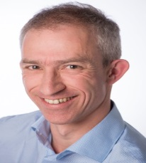

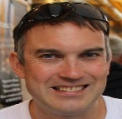
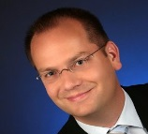

Conclusion
What about that world record?
Mutual integration of Oracle PaaS Cloud services is becoming more natural
The current Oracle PaaS palette offers many options for implementing Platform components
There is some overlap
There is some lack of obvious integration
And there are more services to be added – so next year, a new record!

